Slide 1
Data Analytics (CS40003)
Lecture #1
Introduction to Data
Dr. Debasis Samanta
Associate Professor
Department of Computer Science & Engineering

Slide 2
Today’s discussion…
Introduction to data
Current trend
Big data
Big data vs. small data
Tools and techniques

Slide 3
Introduction to data
Example:
10, 25, …, Kharagpur, 10CS3002, namo@gov.in
Anything else?
Data vs. information
100.0, 0.0, 250.0, 150.0, 220.0, 300.0, 110.0
Is there any information?

Slide 4
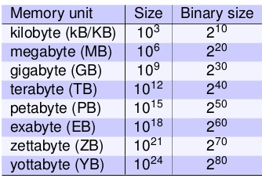
How large your data is?
What is the maximum file size you have dealt so far?
Movies/files/streaming video that you have used?
What is the maximum download speed you get?
To retrieve data stored in distant locations?
How fast your computation is?
How much time to just transfer from you, process and get result?

Slide 5
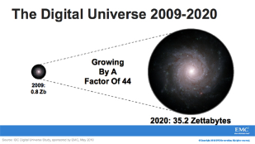

Growth of data

Slide 6
Sources of data
“Every day, we create 2.5 quintillion bytes of data
So much that 90% of the data in the world today has been created in the last two years alone.
The data come from several sources
sensors used to gather climate information
posts to social media sites,
digital pictures and videos
purchase transaction records
cell phone GPS signals
etc. …… to name a few!

Slide 7

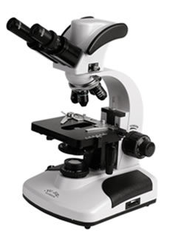

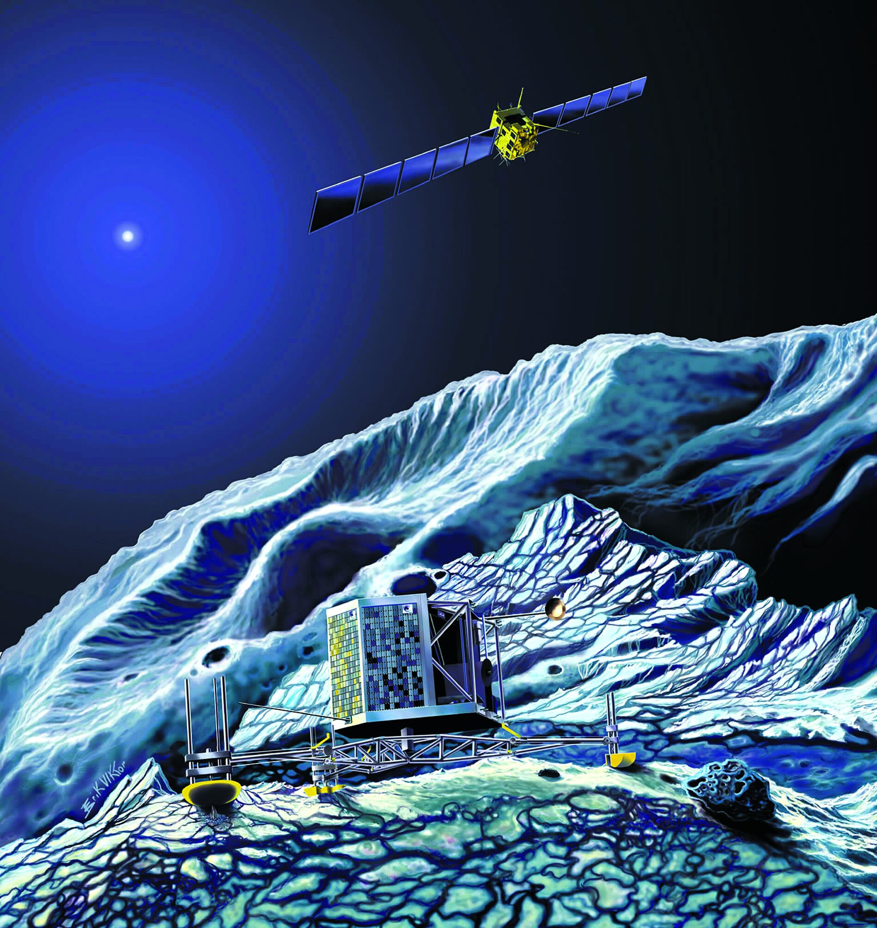
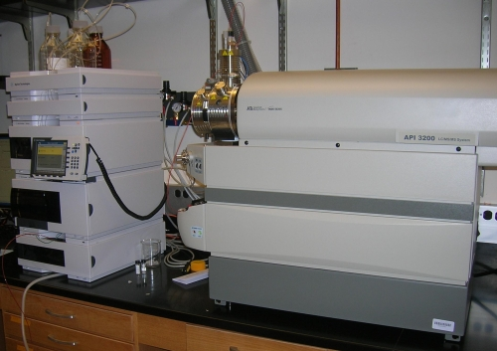
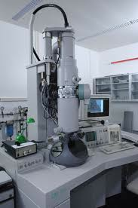

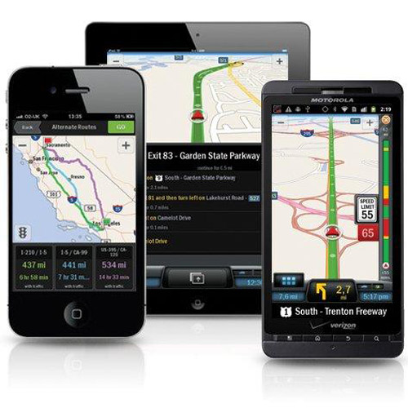
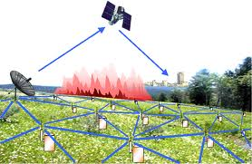
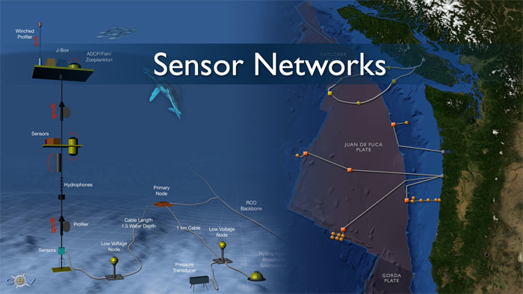
Examples
Social media and networks
(All of us are generating data)
Scientific instruments
(Collecting all sorts of data)
Sensor technology and networks
(Measuring all kinds of data)
Mobile devices
(Tracking all objects all the time)

Slide 8
Now data is Big data!
No single standard definition!
‘Big-data’ is similar to ‘Small-data’, but bigger
…but having data bigger consequently requires different approaches
techniques, tools and architectures
…to solve: new problems
…and, of course, in a better way
Big data is data whose scale, diversity, and complexity require new architecture, techniques, algorithms, and analytics to manage it and extract value and hidden knowledge from it…

Slide 9
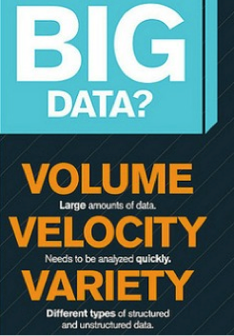
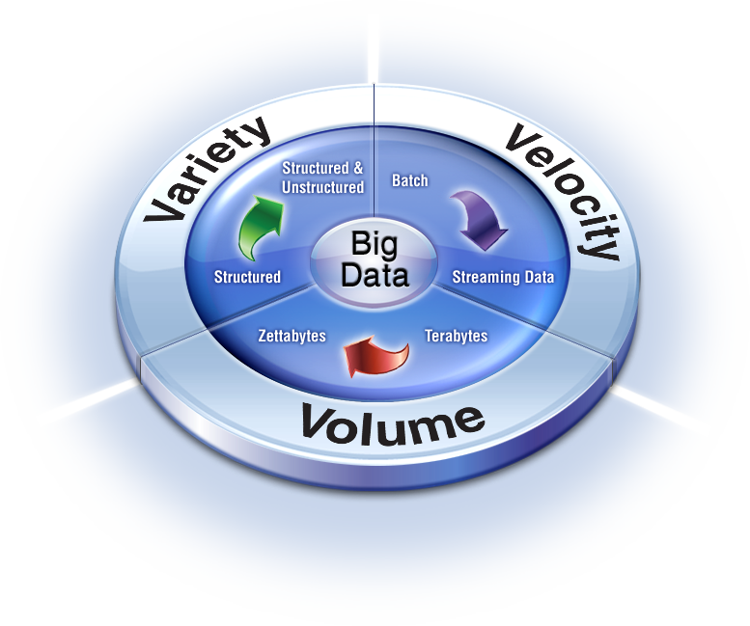
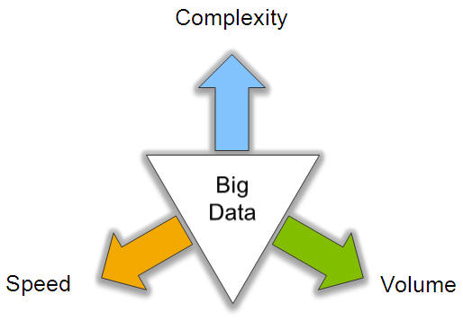
Characteristics of Big data: V3

Slide 10
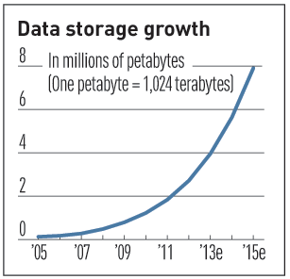
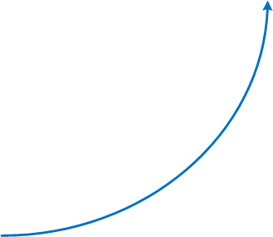
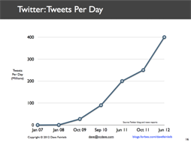
V3 : V for Volume
Volume of data, which needs to be processed is increasing rapidly
More storage capacity
More computation
More tools and techniques

Slide 11
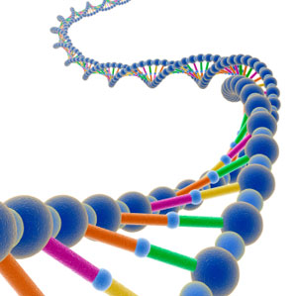
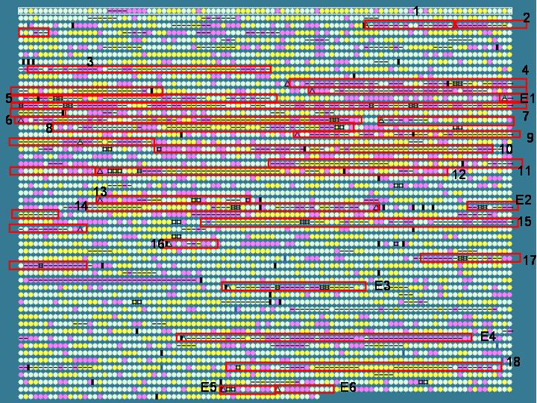
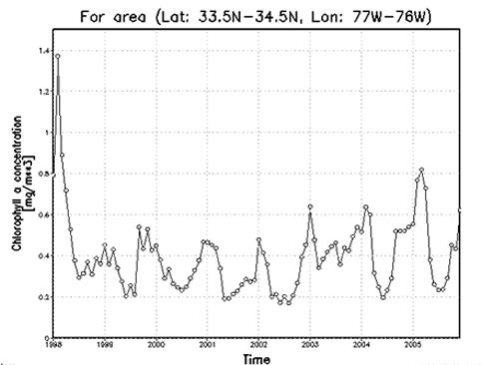


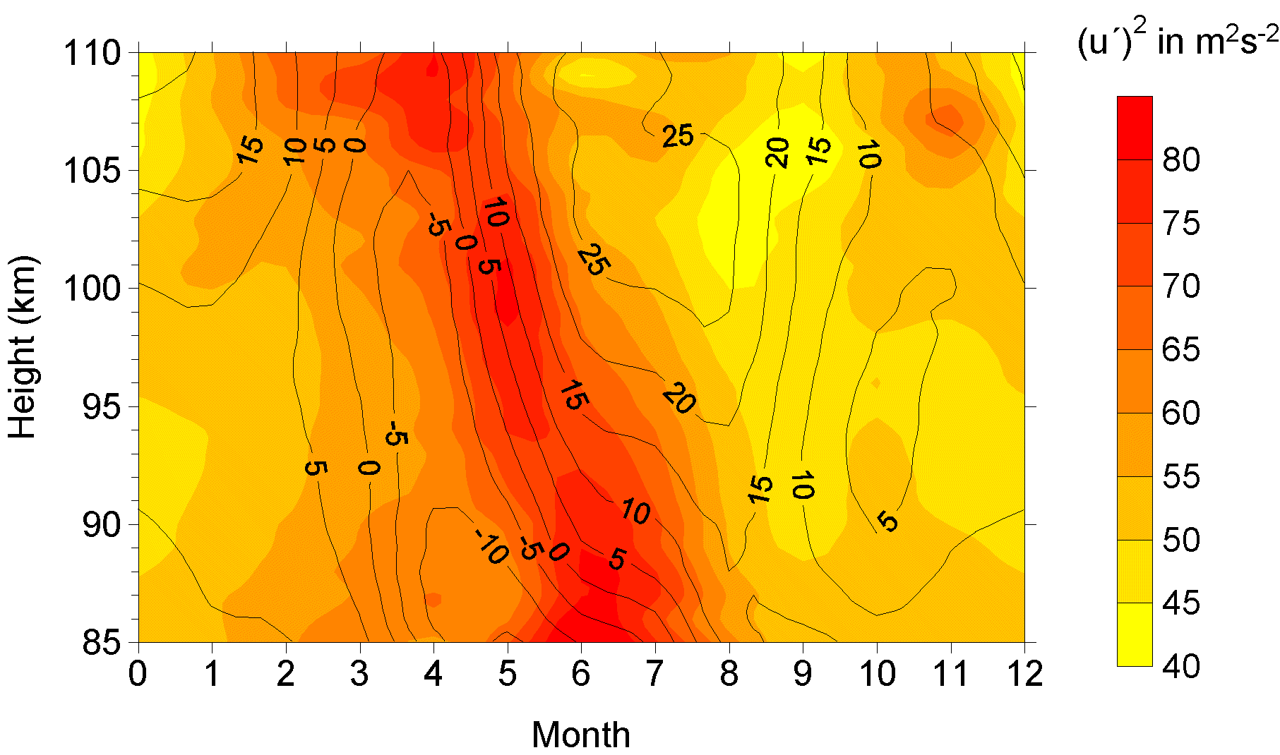
V3: V for Variety
Various formats, types, and structures
Text, numerical, images, audio, video, sequences, time series, social media data, multi-dim arrays, etc…
Static data vs. streaming data
A single application can be generating/collecting many types of data
To extract knowledge➔ all these types of data need to be linked together

Slide 12

V3: V for Velocity
Data is being generated fast and need to be processed fast
For time-sensitive processes such as catching fraud, big data must be used as it streams into your enterprise in order to maximize its value
Scrutinize 5 million trade events created each day to identify potential fraud
Analyze 500 million daily call detail records in real-time to predict customer churn faster
Sometimes, 2 minutes is too late!
The latest we have heard is 10 ns (nano seconds) delay is too much

Slide 13
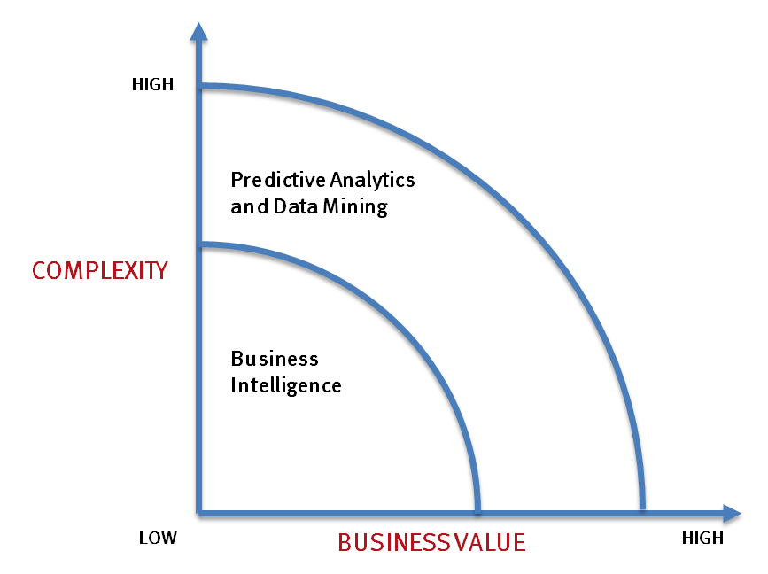
Big data vs. small data
- Optimizations and predictive analytics
- Complex statistical analysis
- All types of data, and many sources
- Very large datasets
- More of a real-time
- Ad-hoc querying and reporting
- Data mining techniques
- Structured data, typical sources
- Small to mid-size datasets

Slide 14
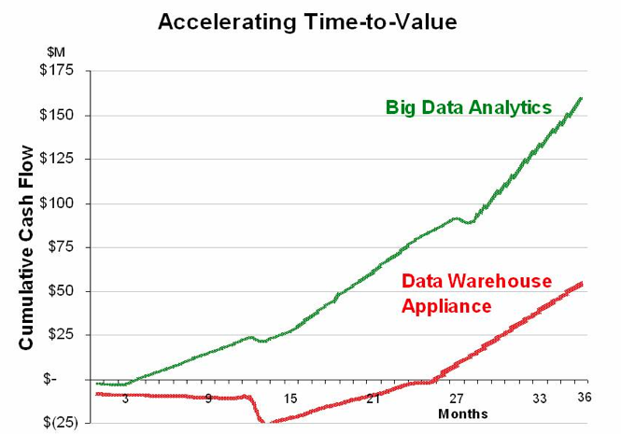
Big data vs. small data
Big data is more real-time in nature than traditional applications
Big data architecture
Traditional architectures are not well-suited for big data applications (e.g. Exa-data, Tera-data)
Massively parallel processing, scale out architectures are well-suited for big data applications

Slide 15
Challenges ahead…
The Bottleneck is in technology
New architecture, algorithms, techniques are needed
Also in technical skills
Experts in using the new technology and dealing with Big data
Who are the major players in the world of Big data?

Slide 16
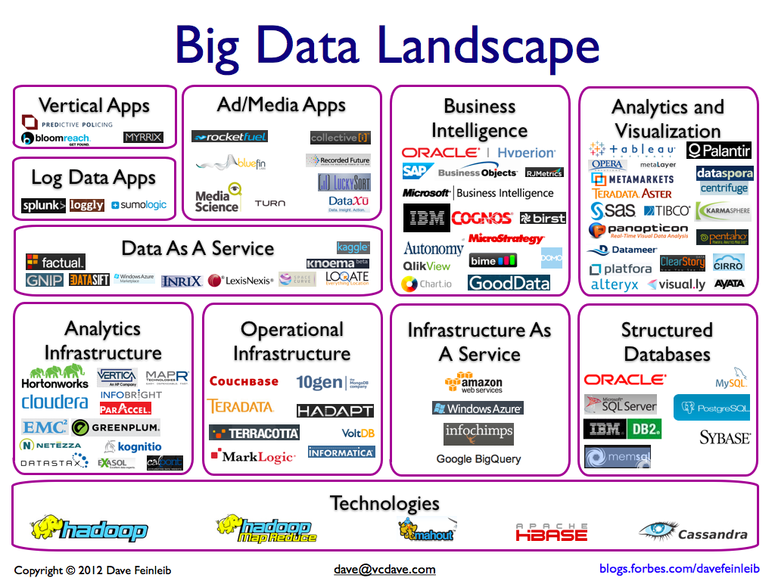
Big data players

Slide 17






Major players…
Google
Hadoop
MapReduce
Mahout
Apache Hbase
Cassandra

Slide 18
Tools available
NoSQL
DatabasesMongoDB, CouchDB, Cassandra, Redis, BigTable, Hbase, Hypertable, Voldemort, Riak, ZooKeeper
MapReduce
Hadoop, Hive, Pig, Cascading, Cascalog, mrjob, Caffeine, S4, MapR, Acunu, Flume, Kafka, Azkaban, Oozie, Greenplum
Storage
S3, HDFS, GDFS
Servers
EC2, Google App Engine, Elastic, Beanstalk, Heroku
Processing
R, Yahoo! Pipes, Mechanical Turk, Solr/Lucene, ElasticSearch, Datameer, BigSheets, Tinkerpop

Slide 19
Any question?
You may post your question(s) at the “Discussion Forum” maintained in the course Web page.

